Slide 1
Understanding Happiness
Daniel Csúr

Slide 2
The Happiness Agenda for Today
Maslow's pyramid & its transformation
Some Happiness Models
Income-Happiness distribution
Combinations of models -> The plasticity of Models
Happiness and globalisation
Increase in Total Happiness vs Equal distribution of Happiness -> Example of USSR
Sustainability & Happiness
Creating out Happy country

Slide 3
How is it possible to measure happiness if it can not be defined properly?
Is there something like "enough" happiness?
To what extent does happiness depend on cultural aspects (some people might even be happy after satisfying the "safety" step of Maslow´s hierarchy)? If it depends on culture how is it possible to compare nation´s degree of happiness?
Do you think happiness decreased with globalization (access to more information might show people that they while being one of the lucky ones in their country are wore off if compared to other nations)?
If the world becomes more sustainable Western countries would certainly have to change their life style. Don´t you think this would rather make them less happy? -> My Research
What aspects are crucial to increase total happiness in a country (equality, reduction of poverty, education, wealth...?)?
What should be the ultimate goal: increasing total happiness or increasing the equal distribution of happiness?
Generally, we would appreciate it if you could give us your opinion about the connection between sustainability and happiness and some more models (such as the Maslow´s hierarchy)

Slide 4
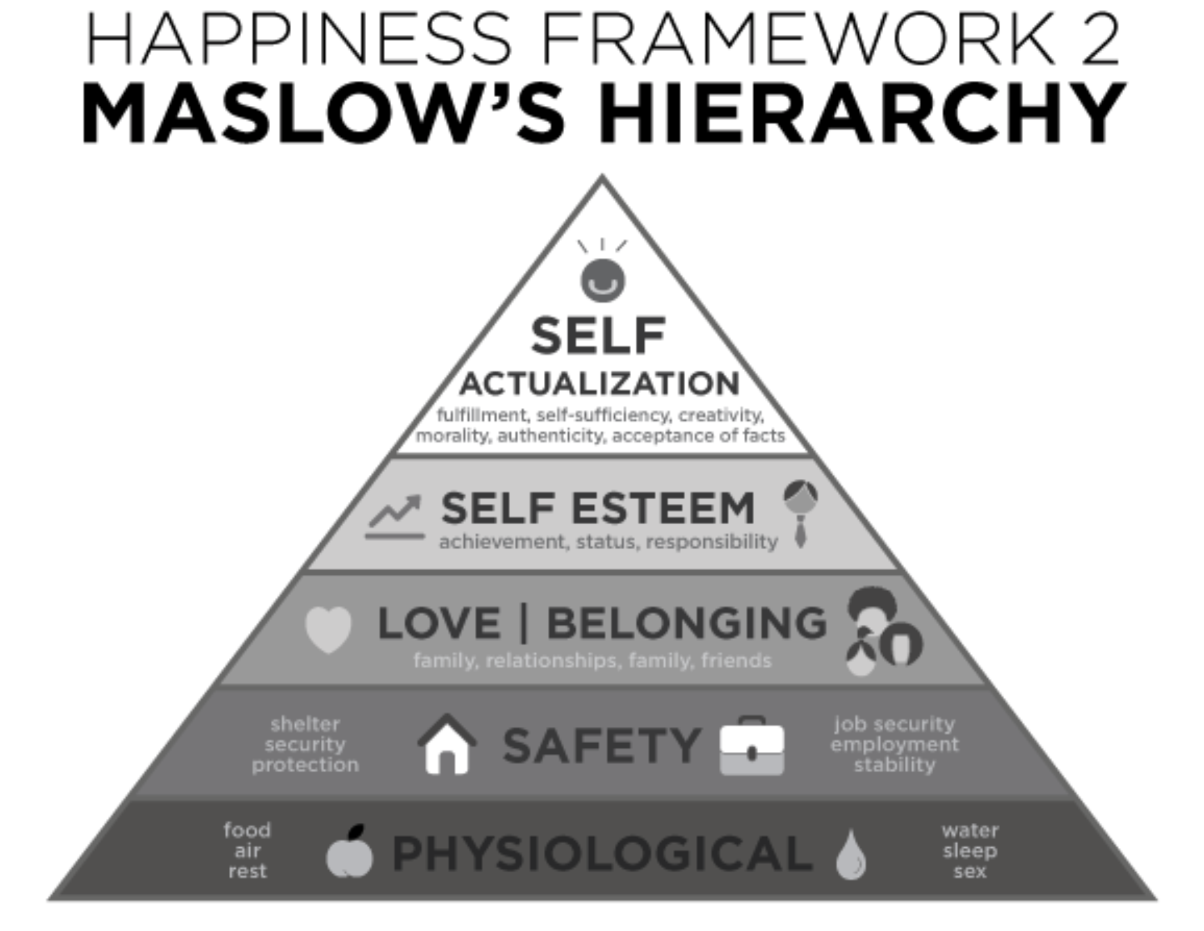

Slide 5
Layers of societal Happiness
HAPPINESS
Society
Acquaintances
Citizens
Community
Individual
Physiological
Psychological
Family
Colleagues
Friends

Slide 6
Measuring Happiness?
Taking all things in account, how happy are you with your life overall?
Not Happy at all, Not Very Happy, Fairly Happy, Very Happy
How happy are you with your life on average?
Not happy, Not very happy, Very Happy
Recently used 10-grade scales for greater precision?
UN (World Happiness Report) OECD (Better Life Index), Gallup World Poll, World Values Survey, Bhutan Happiness Index, European Social Survey,

Slide 7
Differences in Cultural Happiness

Slide 8
Gallup World Poll The most advanced measuring techniques
Define your own happiness → In your own words what happiness means to you
Define your own happiness scale Self-anchoring → Fairly happy might mean different -> Firstly ask you about your choosing preferences → Then phrase the answers
Ask more questions → Health, Family, Education, Corruption
Create relative and absolute averages
Analyze & Publish
The Happiest Countries - Denmark, Norway, Iceland, Switzerland
The Least Happy Countries - Togo, Burundi, Syria, CAR

Slide 9
Where are people happy?

Slide 12
How People Work?

Slide 13
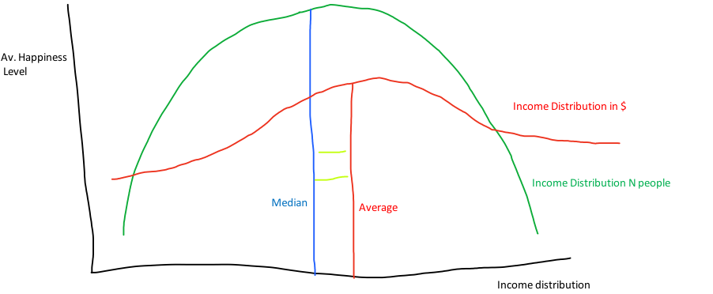
Income / Happiness Distribution graph – High Equality

Slide 14
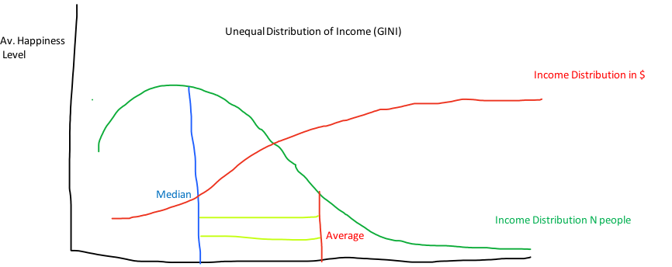
Income / Happiness Distribution graph High Inequality
Income distribution

Slide 15
Happiness & Globalisation
More Available information, people might seem less happy
You can see all the amazing in the world but also all the bad
https://ourworldindata.org/happiness-and-life-satisfaction
Did we become happier over time? -> Not really, your relative position changes
Distribution curve and it’s change over time
OECD – Better Life Index -> http://bit.ly/2oGFOWv (manipulation?)

Slide 16
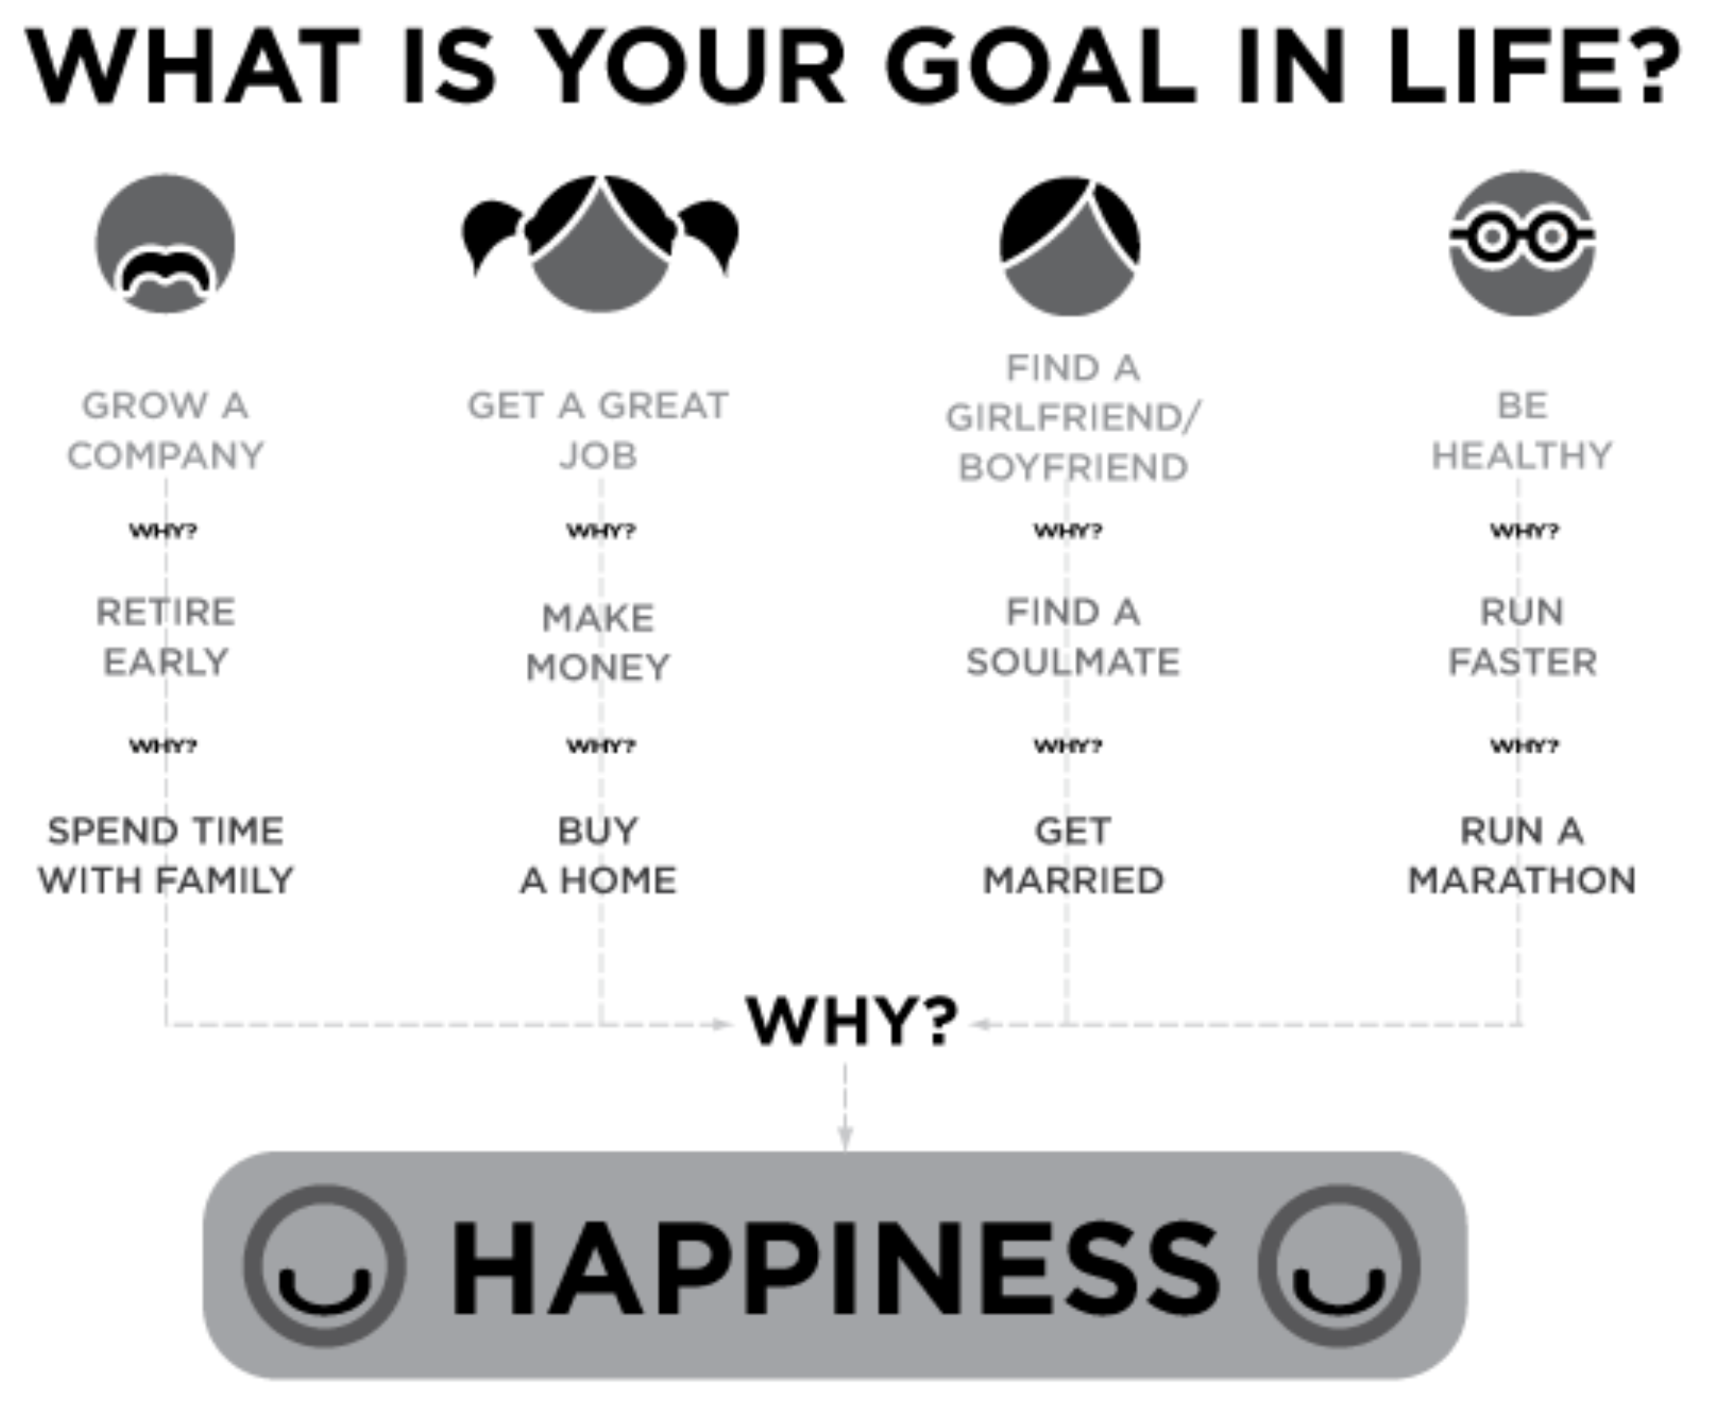
Why should we actually care about Happiness?

Slide 17
Designing the Happiest Country on Earth

Slide 18
Equality
Good Healthcare
High-Income
Service Industry
Innovations
Low Unemploy- ment
Long Life
Democracy & Freedom
Rule Of Law

Slide 19
Equality
Good Healthcare
High-Income
Service Industry
Innovations
Low Unemploy- ment
Long Life
Democracy & Freedom
Rule Of Law

Slide 20
Equality
Good Healthcare
High-Income
Service Industry
Innovations
Low Unemploy- ment
Long Life
Democracy & Freedom
Rule Of Law

Slide 21
Question??? If not all the factors are equally achievable which ones are the most important and how do we decide?

Slide 22
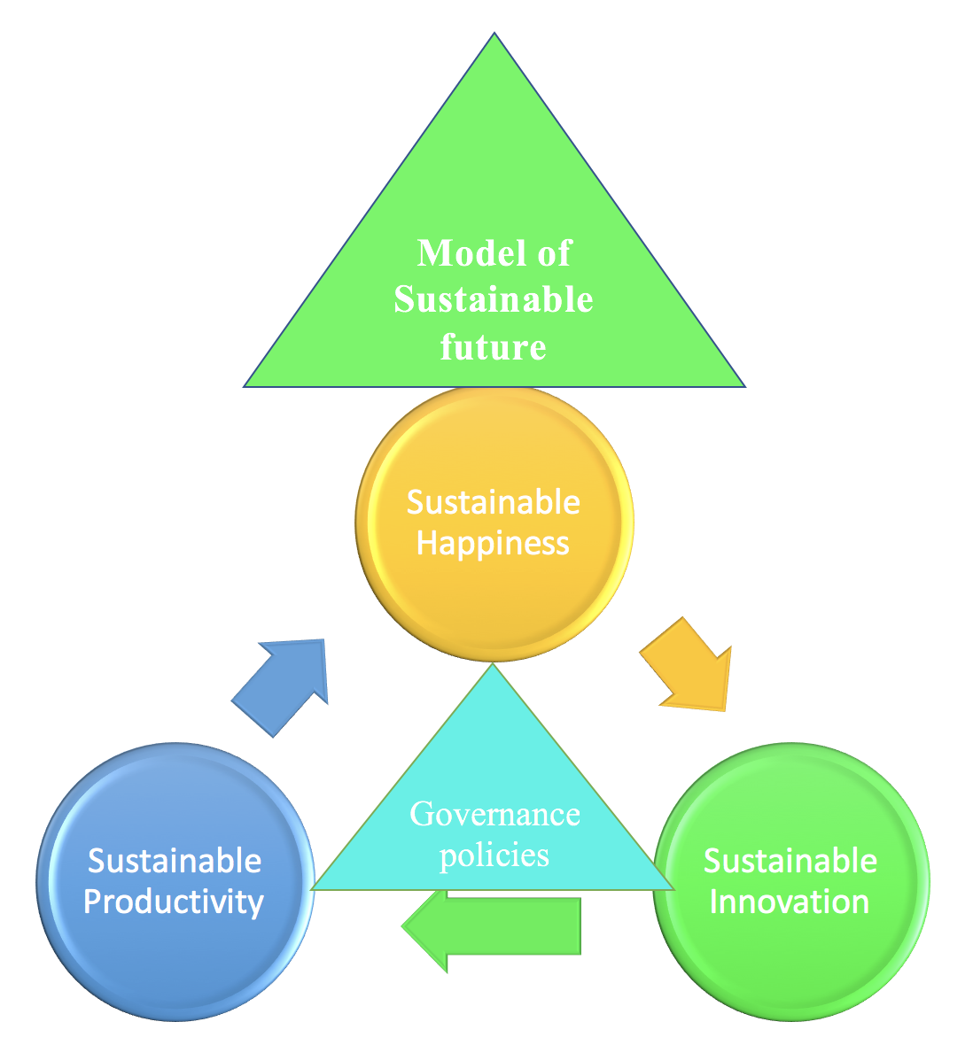

Slide 23
But can we have all the countries Equally Happy?

